Slide 1
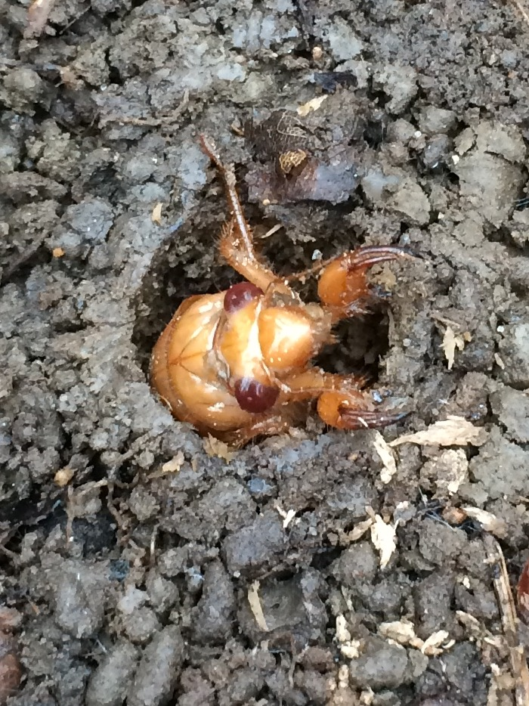
The Return of the
Periodical Cicadas

Slide 2
17 Facts and 17 year cicadas
https://www.youtube.com/watch?v=x71RaI-RxVM&nohtml5=False
This video clip is 18 minutes but VERY informative. Please watch.

Slide 3
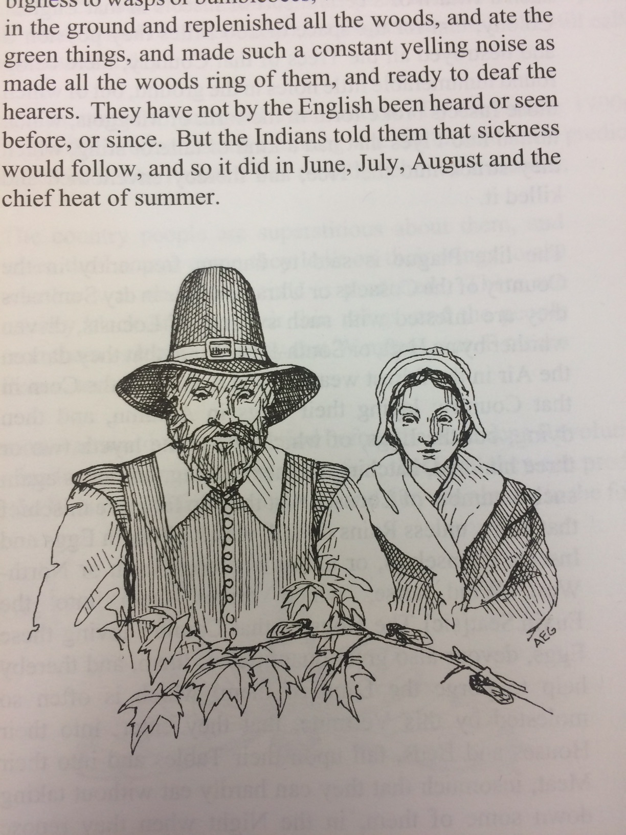
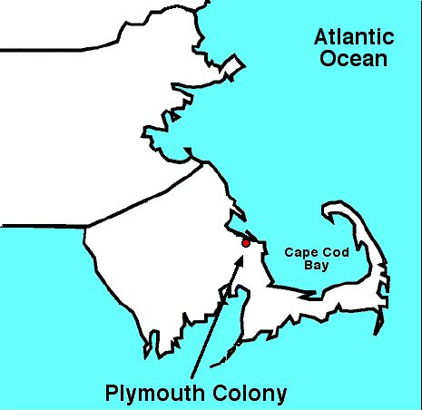
1633
12 years after first Thanksgiving
Governor of Plymouth Colony, William Bradford
Plymouth Colony residents gaze upon cicadas, Kritsky, 1999
Notes:
http://www.thepeoplehistory.com/1999.html

Slide 4
“And the spring before, especially all the month of May, there was such a quantity of a great sort of flies like for bigness to wasps or bumblebees, which came out of holes in the ground and replenished all the woods, and ate the green things, and made such a yelling noise as made all the wood ring of them, and ready to deaf the hearers.”

Slide 5

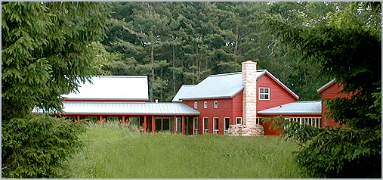

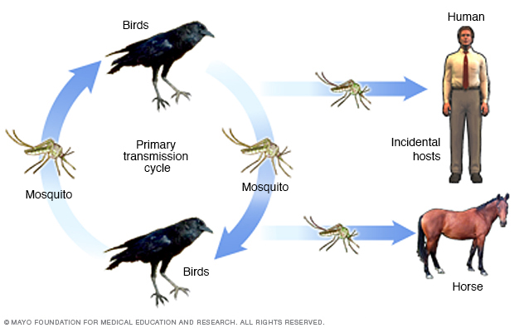
What were you doing in 1999?
1999
Y2K
6 Billion
Add a picture of Me from 1999
Myspace was officially released to the internet
Bluetooth announces
Star Wars episode I: the Phantom menace was released
Who wants to be a Millionaire with Regis Phillban!
Lance Armstrong won his first Tour De France
The West Nile Virus first appears in the U.S.
Bill Clinton impeachment proceedings
The Sixth Sense
Baby one more time – Britney Spears
Mambo No 5
3rd volume in the Harry Potter series, prisoner of Azkaban was released
Dial up internet
Notes:
http://www.thepeoplehistory.com/1999.html

Slide 6
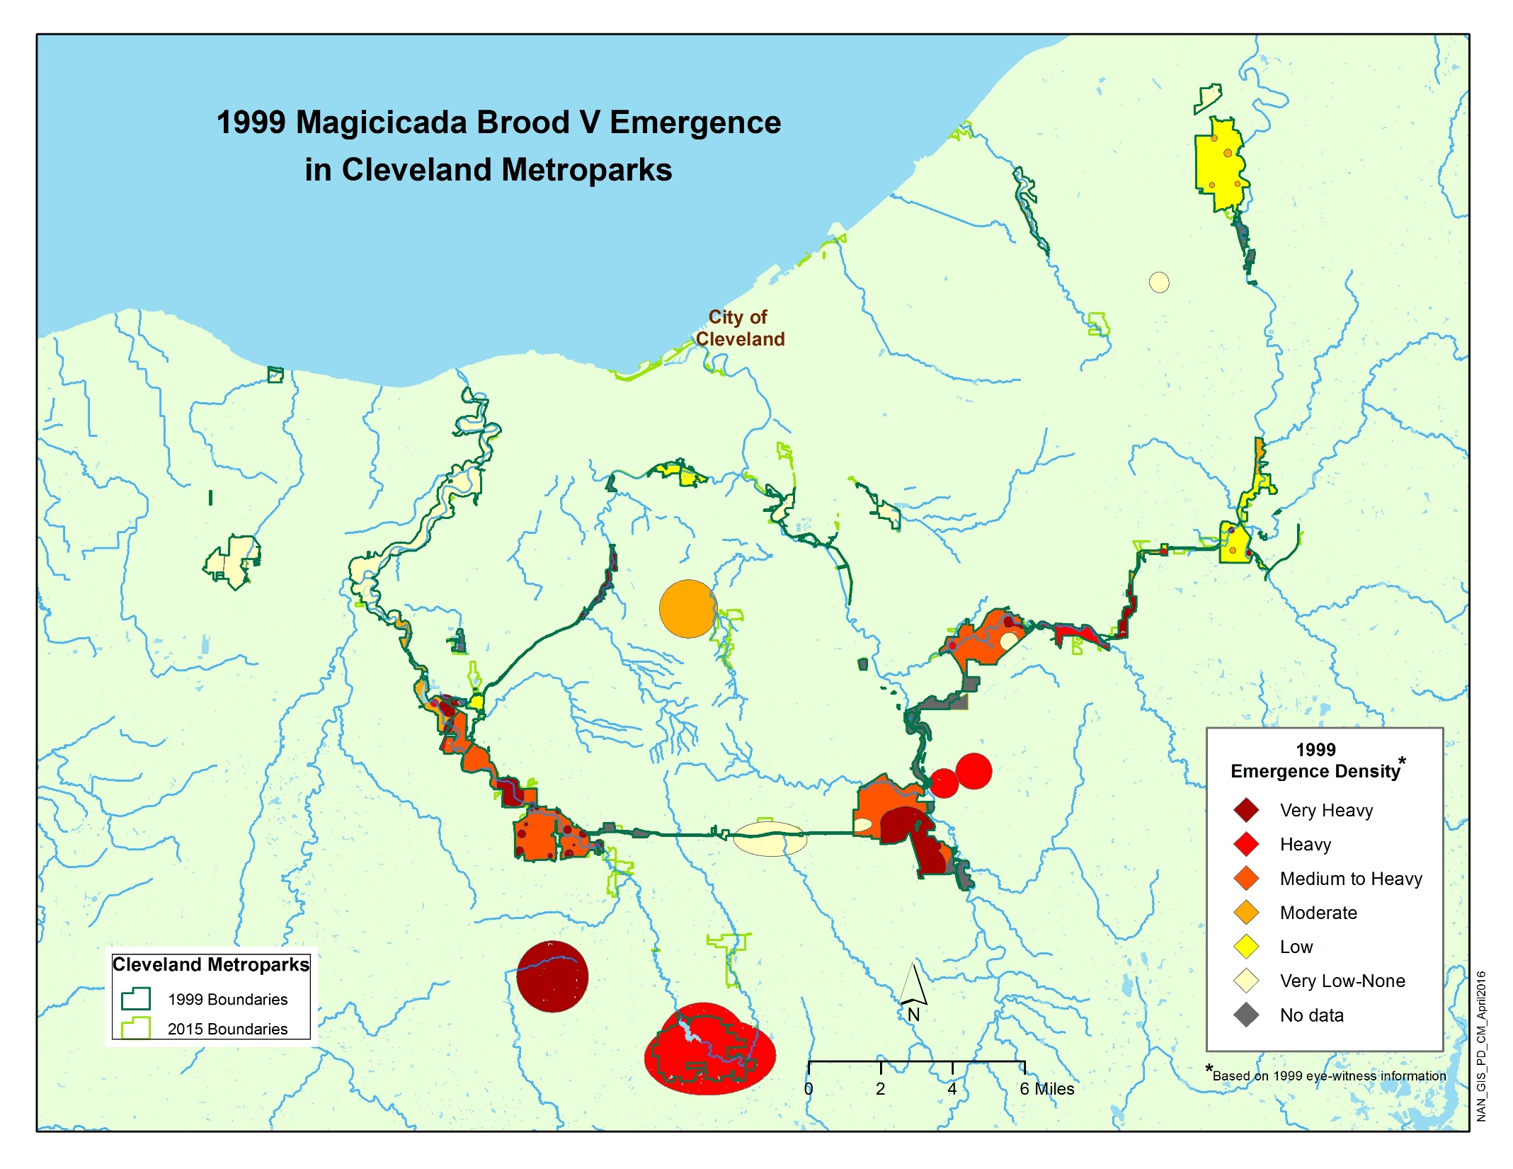
Counties and locations of the 1999 emergence of the periodical cicadas
Recorded if two (2) “swarms” present and five (5) additional reports
County | City
Cuyahoga | Bedford
Cuyahoga | Berea
Cuyahoga | Brecksville Reservation
Cuyahoga | Brecksville
Cuyahoga | Garfield Heights
Cuyahoga | North Royalton
Cuyahoga | Olmstead Falls
Cuyahoga | Parma
Cuyahoga | Peninsula
Cuyahoga | Solon
Cuyahoga | Strongsville
Cuyahoga | Strongsville Wildlife Refuge
Kritsky, 1999
Notes:
Southern Cuyahoga County - More than 20 current and past employees

Slide 7
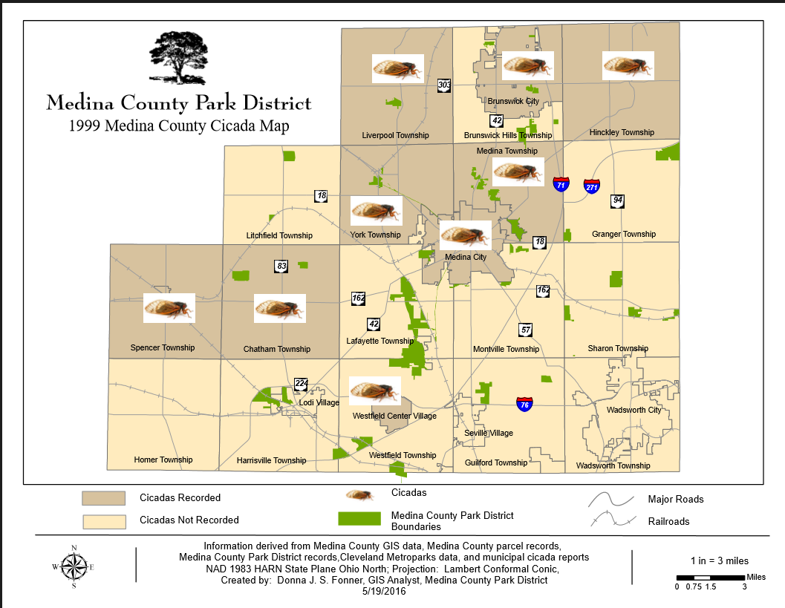
County | City
Medina | Chatham
Medina | Hinckley
Medina | Mallet Creek
Medina | Medina
Medina | Medina Twp.
Medina | Spencer
Medina | Valley City
Medina | Westfield
Kritsky, 1999
Notes:
Medina County – few records!

Slide 8
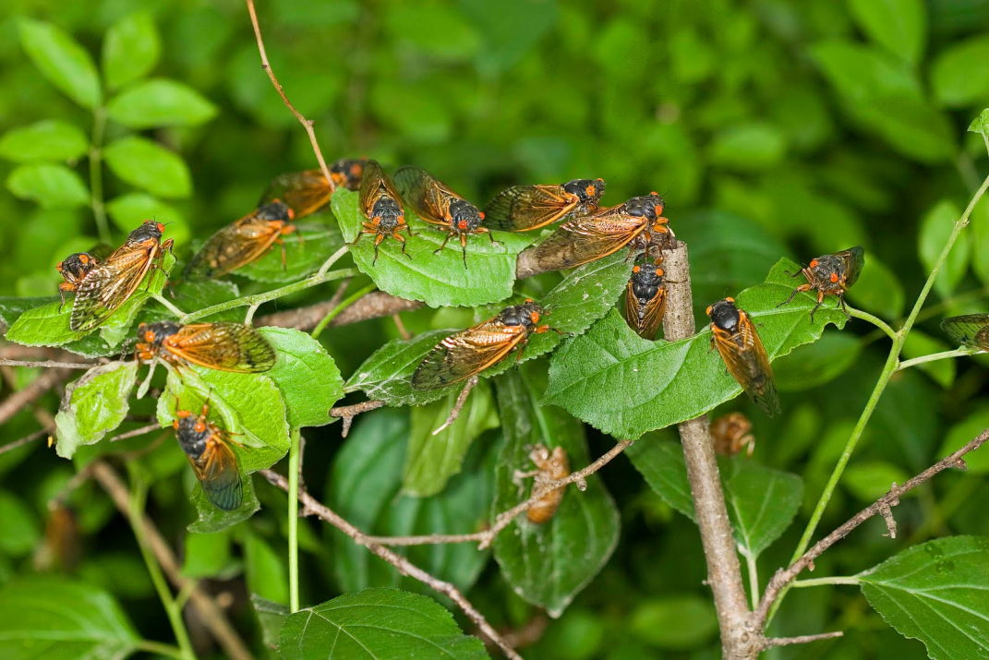
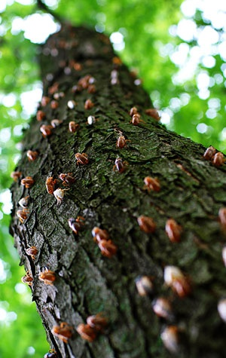
They are coming!
They are coming!!
Late-May thru
Late June 2016!
Radio Lab
Notes:
They are coming, There are a lot of them.

Slide 9
Itinerary
Classification
Life history
Interactions
Distribution
Species identification
Citizen Science

Slide 10
Classification
3,390 known species in the world
Over 190 species in North America
  18 in Ohio
Exist on every continent except Antarctica
3 sp. are 17 year cicadas
4 sp. are 13 year cicadas
Kingdom Animalia
Phylum Arthropoda
Class Insecta
Order Hemiptera
Suborder Auchenorrhyncha
Family Cicadidae
There are over 190 varieties (including species & subspecies) of cicada in North America, and over 3,390 varieties of cicadas around the world. Cicadas exist on every continent but Antarctica.
Straight up good source for cicada information
Notes:
Total sp. Includes annual and periodical combined

Slide 11
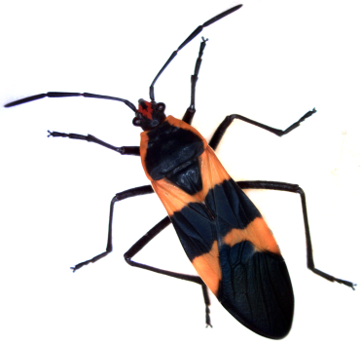
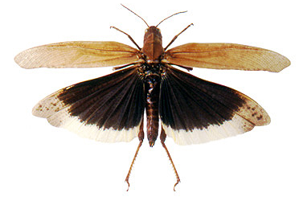
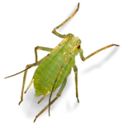
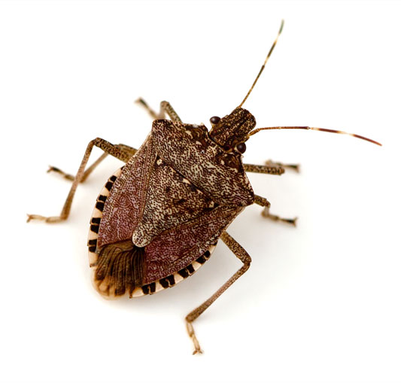
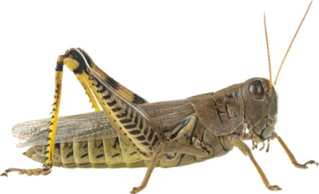
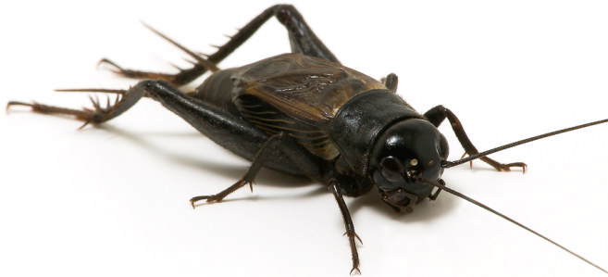
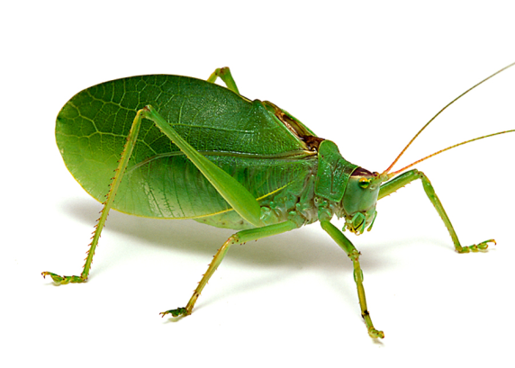
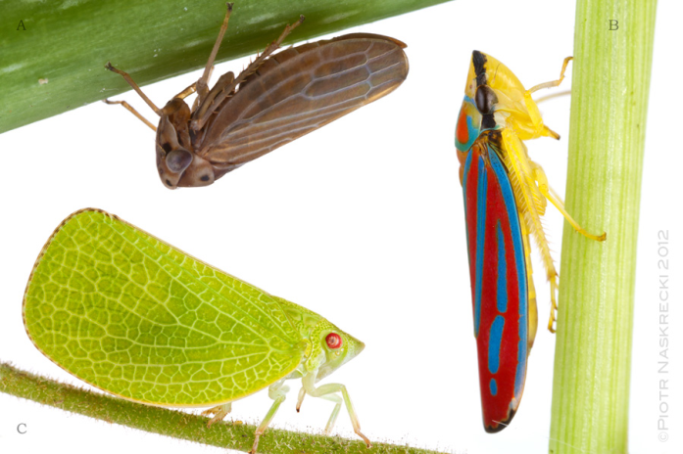
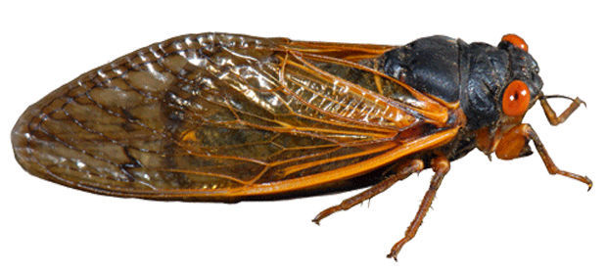
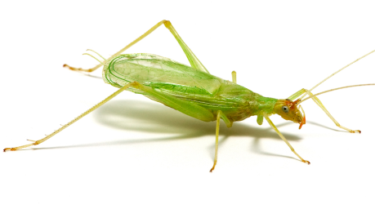
Order Hemiptera
Order Orthoptera
Sucking mouthparts
Chewing mouthparts
Locust
Aphids
Shield bugs
Grasshoppers
Crickets
Katydids
Leafhoppers
Cicadas
Notes:
How do they sing? They don’t use their legs and they don’t use their wings. They use their tymbals!
You’ll notice the true locusts have HUGE rear legs for hopping, long antennae, and relatively long bodies. True locusts chew the plants they consume, while Magicicadas suck fluids from trees.

Slide 12
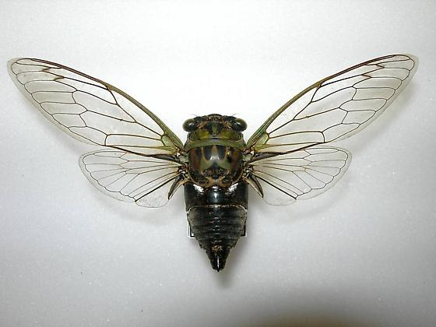
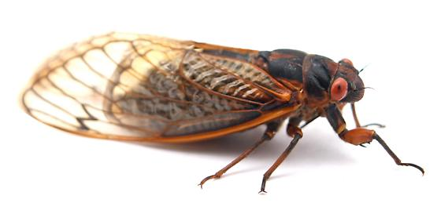
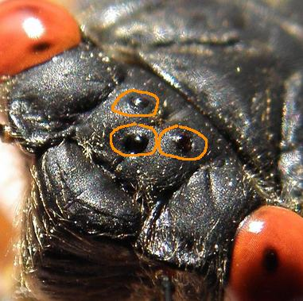
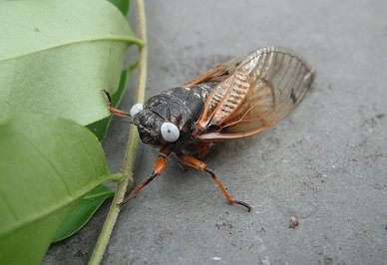
Annual (Dog Day)
Periodical
Neotibicen* pruinosis
Magicicada septendecim
Magicicada cassini
Magicicada septendecula
Bugguide.net
Bugguide.net
10 species in Neotibicen Genus
Green & black – cryptic camo
2 – 5 year life cycle - emerge every year
Can sing later into the evening
3 species in Ohio
Orange & black
17* year life cycle
Tend to sing during the day
Notes:
Cicadas have two, obvious, large, compound eyes, and three ocelli. Ocelli are three jewel-like eyes situated between the two main, compound eyes of a cicada. We believe ocelli are used to detect light and darkness. Ocelli means little eyes in Latin.

Slide 13
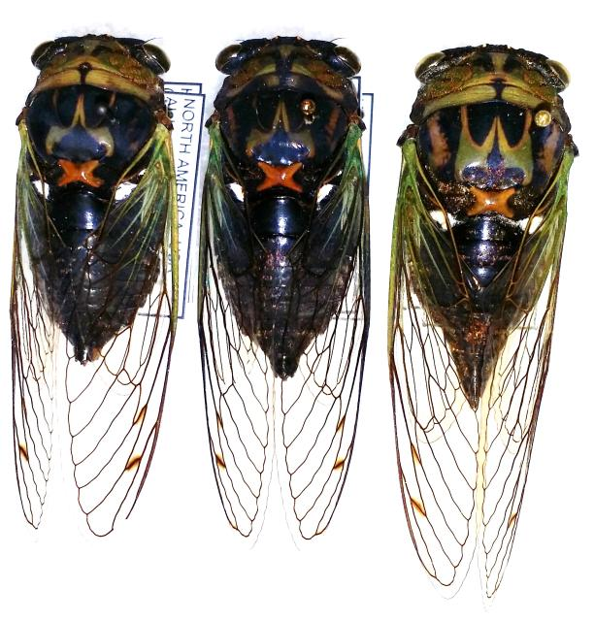

Annual or Dog Day Cicadas
Cryptic camouflage
Emerge every year
Can sing later into the evening
Have 3 oceli, 2 compound eyes
Song changes throughout the day
Sometimes called “harvestfly”
Well-distributed in Ohio
Scissor-grinder cicada
Neotibicen pruinosus pruinosus
Swamp cicada
Neotibicen tibicen
AKA the soundtrack of summer
Notes:
Other species Cicadetta, Neocicada

Slide 14
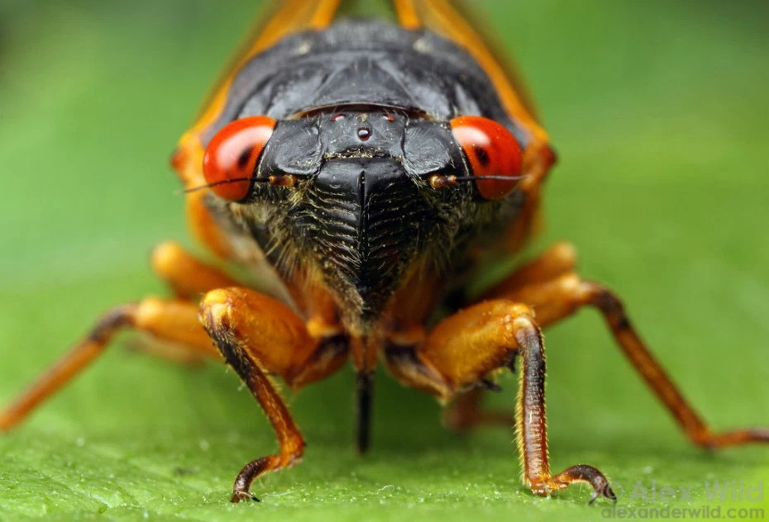
Life History
Photo credit to Alexander Wild

Slide 15
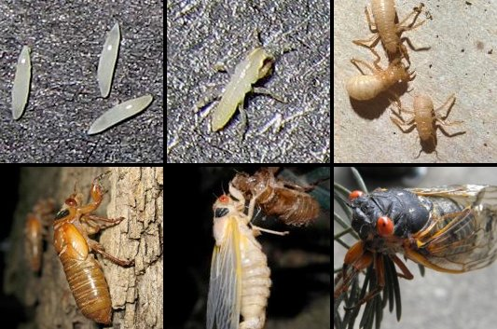
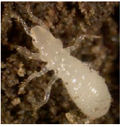
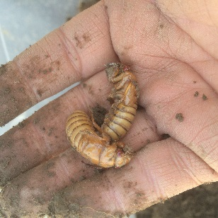
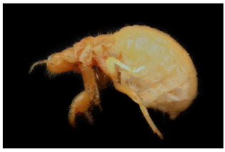
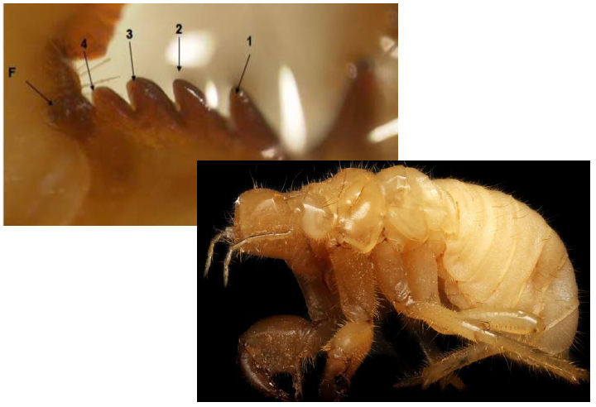
Egg
6-8 weeks
Adult
2-6 weeks
1st instar
<1 year
Magicicada
Life Cycle
Ecdysis & hardening
1 night… + 3-5 days
2nd instar
3-6 years
5th instar
3-5 years
3rd instar
3-5 years
4th instar
3-5 years
Notes:
Identification: http://www.cicadamania.com/where.html

Slide 16
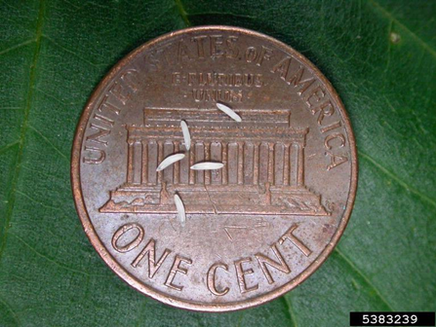
Egg
6-8 weeks
1st instar
<1 year
Smaller than a grain of rice
Notes:
Identification: http://www.cicadamania.com/where.html
Tibia and femur.

Slide 17
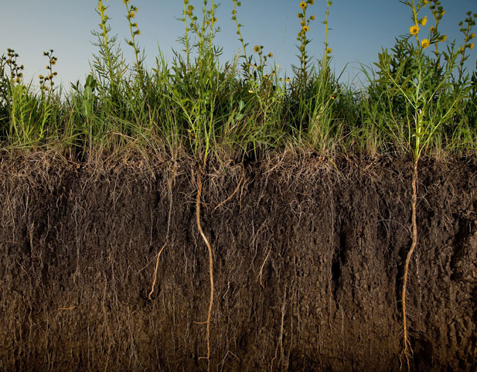
Egg
6-8 weeks
1st instar
<1 year
Feed on tender rootlets, often from grasses
Notes:
Identification: http://www.cicadamania.com/where.html
Tibia and femur.

Slide 18
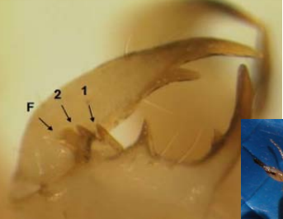
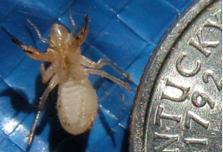
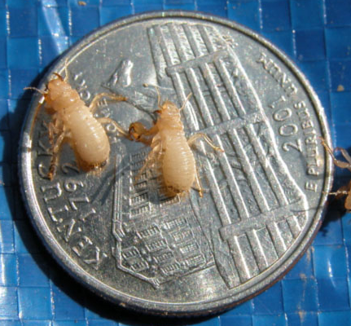
Egg
6-8 weeks
1st instar
<1 year
2nd instar
3-6 years
Teeth on femur is used to age nymphs
Notes:
Identification: http://www.cicadamania.com/where.html
Tibia and femur.

Slide 19

Egg
6-8 weeks
1st instar
<1 year
2nd instar
3-6 years
3rd instar
3-5 years
Notes:
Identification: http://www.cicadamania.com/where.html

Slide 20
Egg
6-8 weeks
1st instar
<1 year
2nd instar
3-6 years
3rd instar
3-5 years
4th instar
3-5 years
Notes:
Identification: http://www.cicadamania.com/where.html

Slide 21
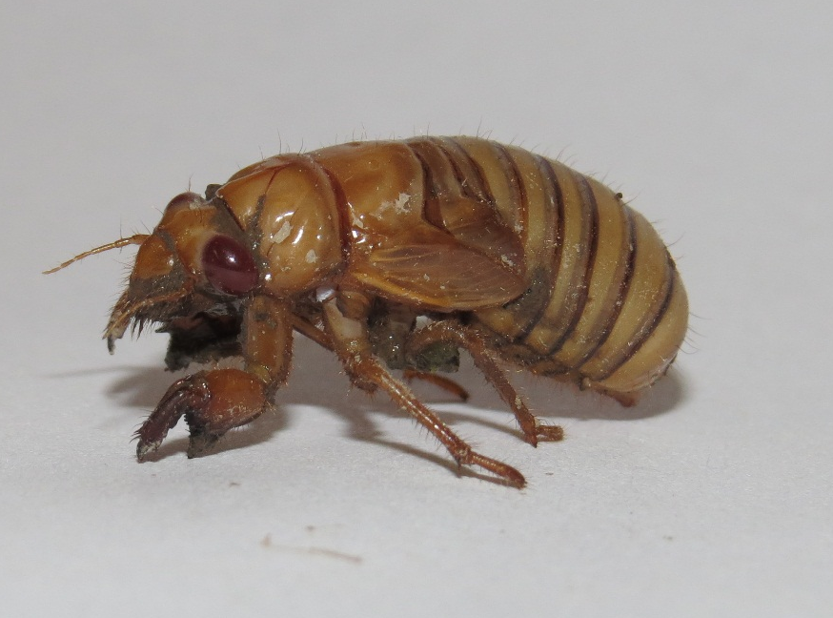
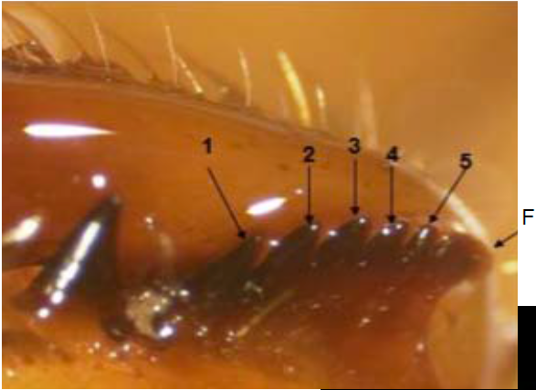
Egg
6-8 weeks
1st instar
<1 year
2nd instar
3-6 years
5th instar
3-5 years
3rd instar
3-5 years
4th instar
3-5 years
Notes:
Identification: http://www.cicadamania.com/where.html

Slide 22
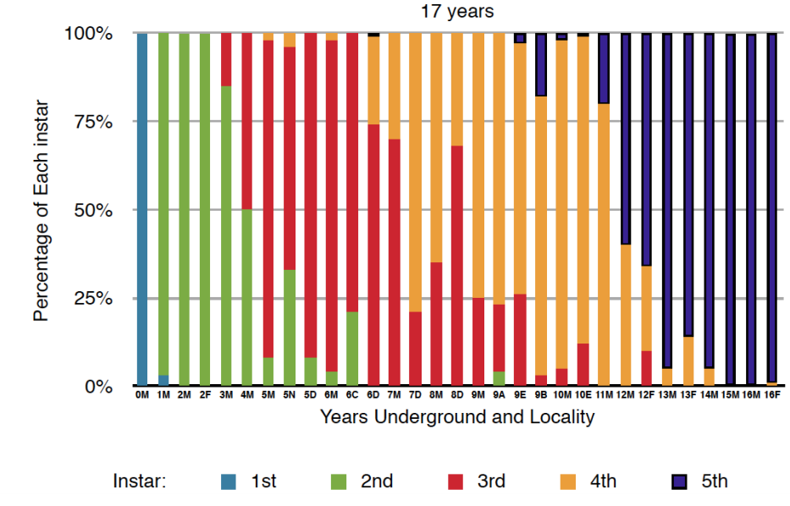
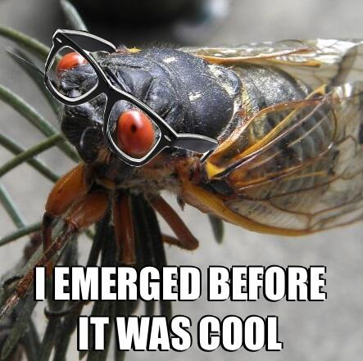
Magicicada Nymph Development
Feed at depths of ~2ft or more
No photoreception
Do not get temperature cues
Stragglers – emerge before or after
Simon, 2013
Notes:
Identification: http://www.cicadamania.com/where.html
Scientists are unsure how cicadas can "calculate" the passage of 17 years. It may relate to the recognition of annual moisture or dryness cycles, combined with gaining appropriate size. Perhaps hormones develop at the correct time to stimulate emergence.

Slide 23
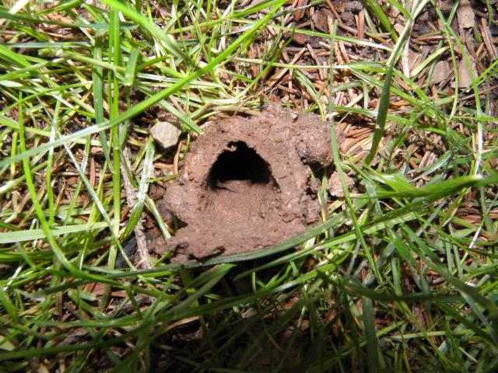
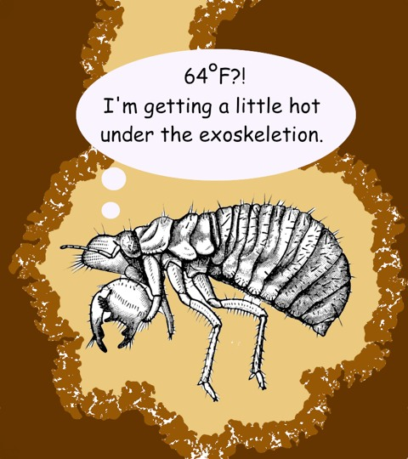
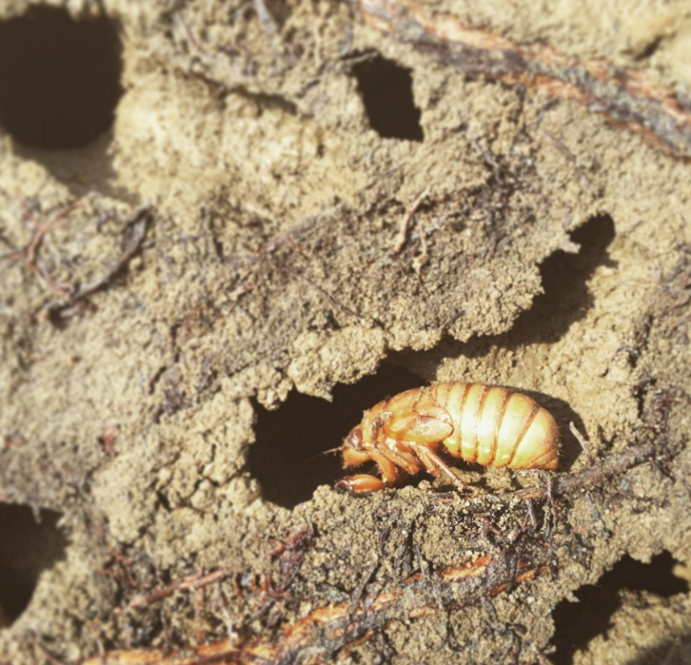
Signs of Emergence
8 inches down …
Mud chimney – look in shady spots!
Flip over logs or flat rocks
Notes:
Multiple cicadas will emerge from one hole

Slide 24
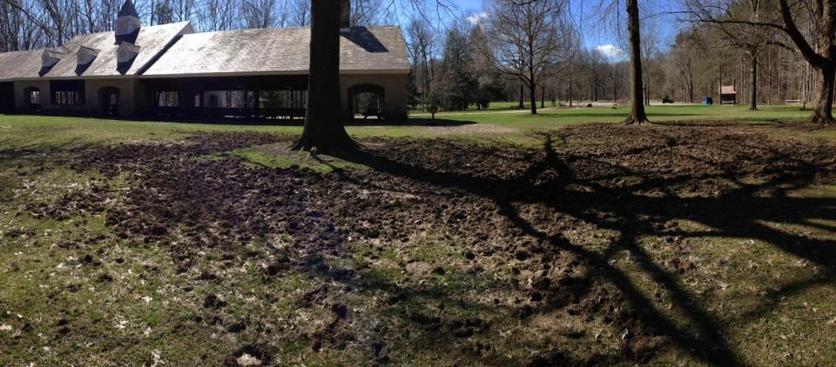
Predator activity
@ South Chagrin
Photo courtesy of Richard B.

Slide 25
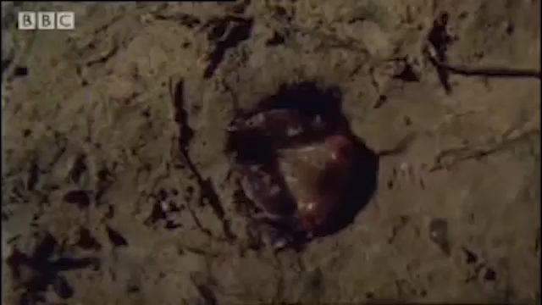
They are coming!
OMG!!
It’s happening!
Notes:
They are coming, There are a lot of them.

Slide 26
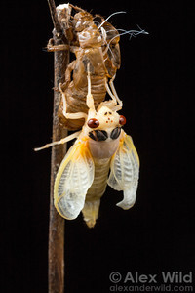
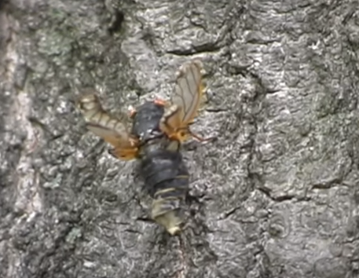
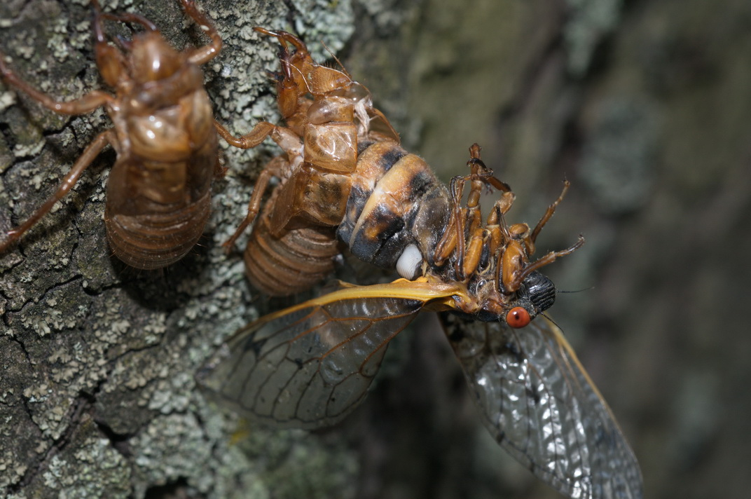
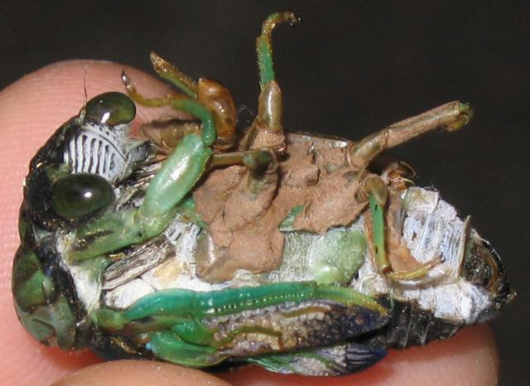
Molting or Ecdysis
“Crumbly”
Often trample others in the rush to find a place to molt
Harsh weather, like wind and rain
Malnutrition
Fungi infection
Molt hanging head up
At night
Avoid desiccation
Notes:
Clip 35,15:10 in Ken’s video

Slide 27



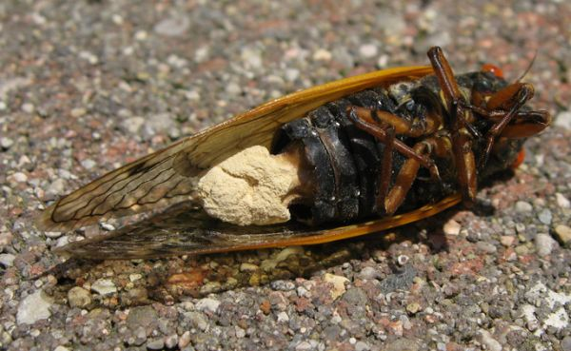
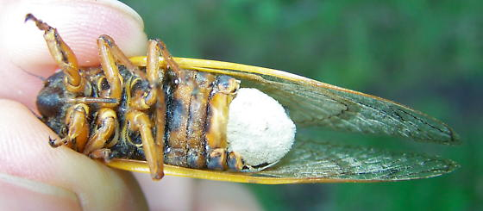
Massospora cicadina
Why don’t these cicadas have butts?
Fungus!
The Massospora fungus infects Magicicadas, filling their abdomens and destroying their ability to reproduce. Often, their entire abdomen will fall off. The cicadas actually spread the fungus throughout their local colony via mating — the Massospora fungus is a cicada STD!
Notes:
Flying Salt Shakers of Death!
https://blog.mycology.cornell.edu/2013/02/19/flying-salt-shakers-of-death/

Slide 28


Slide 29


Anatomy Male
- Make sound by flexing their tymbals
- Small muscles rapidly pull the tymbals in and out of shape — like a child's click-toy
- Sound is intensified by the cicada's mostly hollow abdomen
Notes:
Tymbals - drum-like organs found in their abdomens
Females chose the male that interests them with a flick of their wings which stimulates the male to come closer. but it isn't the same as the song cicadas are known for. If you snap your fingers you can get males to call.

Slide 30


Female & Male Physiology
Epiproct - single appendage projecting upward
Notes:
Females have pointed abdomen w/ovipositor
Males have blunt abdomen

Slide 31


Magicicada: Expert home shopper
- Big, Hearty North American Trees!
elm, chestnut, ash, maple, and oak
Pick a tree that will survive 17 years
- Often select edge of forest trees/ orchard trees
Avoid for egg laying because the sap interferes with their egg nests.
Notes:
Like ovipositing on trees on the edge of a forest, probably because their offspring will be more likely to find grass roots when they leave their egg nests. An orchard is all “edge of the a forest” because of the rows between the trees,

Slide 32


Signs of Egg Laying
Oviposition evidence
Flagging
Scarring and egg nests in pencil-diameter twigs
Rutgers
Notes:
Lay eggs in pencil sized twigs. 10-20 eggs per egg nest. One female can lay up to 400-600 eggs.
They will flag the branches of these trees, but only young ones are at risk.

Slide 33

Human interactions:
Do not bite or sting
Not known to transmit diseases
Are not harmful to pets
Are low-carb and gluten free
Are fun and interesting
Provide MEMORIES!

Slide 34

Distribution
17 year cicadas
Zone of overlap
13 year cicadas

Slide 35

15 total
Broods 1-17 for 17 year
Total of 12 active broods
Broods 18-30 for 13 year
Total of 3 active broods
Notes:
2 extinct broods
No number represents empty class
4 broods exist in Ohio

Slide 36

Extant periodical cicada broods in the U.S.

Slide 37

MD, OH, PA, VA, WVA
“Our” brood
First observed in 1812

Slide 38




Slide 39


Cicadas populations over time
Brood V in 1914
Brood V in 1999
Kritsky (1999)
Notes:
What geography encouraged these things to move around this area?

Slide 40

Brood V range over time
Shows the changes in cicada populations over time
Receding populations around Columbus and Youngstown

Slide 41

Species Identification

Slide 42


Magicicada septendecim
Broad orange stripes on abdomen
Orange on sides of thorax, behind eye
Pharaoh or Wee Ooh
70% of Brood V
Deposits eggs in upland forest
Least host specific
Cooley
Court I
Court II
Distress
Notes:
http://www.magicicada.org/about/species_pages/m_sdecula.php
http://www.magicicada.org/about/species_pages/m_scassini.php
http://www.magicicada.org/about/species_pages/m_sdecim.php

Slide 43

Magicicada cassini )
Abdomen all black – potentially weak yellow stripes
Series of ticks followed by a shrill buzz
25% of Brood V
Smallest
Deposits eggs in floodplain species
Ash, elm, oaks, other shrubby species
Cooley
Court
Chorus
Distress
Cooley

Slide 44

Magicicada septendecula and Moore 1962
Narrow, well-defined orange stripes
No orange coloration in front of the wing insertion behind the eye
Rhythmic series of ticks
Rare - 5% of Brood V
Usually deposits eggs in upland forest
Hickory and walnut trees
Cooley
Court I
Court II

Slide 45
Pop Quiz!!
1
2
3
Septendecula court
Septendecim court
Multi-species chorus

Slide 46

Citizen Science
Collect data at your convenience
Report on Cleveland Metroparks website
Medina data will be reported to us
Opportunity to fill in the gaps for Medina Co.
http://www.clevelandmetroparks.com/Main/Cicada-Reporting-Form.aspx

Slide 47
Cicada Resources
Ken Gober, 1999
https://www.youtube.com/watch?v=TqEbaQyY-Tc&feature=youtu.be
David Attenborough, BBC
https://www.youtube.com/watch?v=tjLiWy2nT7U
17 Facts and 17 year cicadas
https://www.youtube.com/watch?v=x71RaI-RxVM&nohtml5=False
How to identify Magicicada species
https://www.youtube.com/watch?v=g4Q065vFFdI
Gene Kritsky, 1999
In Ohio’s Backyard: Periodical Cicadas
Gene Kritsky, 2004
Periodical Cicadas: The Plague and the Puzzle

Slide 48

Thank you for your interest and support!

